Slide 1

Deep Learning for Early Prediction of Fetal Brain Abnormalities from Ultrasound Scans
Team No: 11
Project Advisor: Ms. Shalini Tiwari
Sl. No. | Reg. No. | Name of the student
1 | BL.EN.U4CSE23239 | Nikhil Sanjay
2 | BL.EN.U4CSE23269 | Andrew Tom Matthew
3 | BL.EN.U4CSE23257 | Vedhesh Dhinakaran
1

Slide 2

Introduction
Early diagnosis of fetal brain abnormalities is critical for preventing severe developmental disabilities and improving neonatal outcomes.
Traditional ultrasound interpretation relies heavily on clinician expertise and is subject to:
High inter-observer variability
Low standardization across hospitals
Difficulty detecting subtle or rare disorders
Rare genetic and structural brain anomalies often exhibit:
Overlapping visual patterns
Low-contrast boundaries
Subtle anatomical deviations
Due to these challenges, there is a need for an automated, accurate, and explainable diagnostic model that can assist clinicians in identifying abnormalities reliably using prenatal ultrasound imaging.
2
Notes:
2

Slide 3
Problem Statement
Fetal ultrasound diagnosis of rare genetic and structural brain disorders remains highly challenging due to:
Subtle morphological variations that are difficult to detect visually
High similarity between normal and abnormal anatomical structures
Limited availability of labeled clinical data for rare fetal anomalies
Variations in ultrasound image quality, fetal position, and scanning conditions
Manual interpretation increases the risk of delayed or incorrect diagnosis, which can significantly impact postnatal treatment and survival outcomes.
There is a strong need for an automated and reliable deep learning solution that can detect fetal brain abnormalities early and support clinicians with consistent decision-making.
3
Notes:
3

Slide 4
Literature Review
Sl.No. | AUTHORS | PAPER | INFERENCE
1 | K. P. Shirsat et al. | Fetal brain anomaly detection via ultrasound imaging using traditional and separable CNNs with Xception | Utilized separable convolutions for efficiency, achieving ~85-90% accuracy. However, the model's performance was limited by a small dataset and a short training duration (5 epochs), restricting its generalization capabilities compared to deeper architectures.
2 | O. O. Agboola et al. | Deep learning approaches to identify subtle anomalies in prenatal ultrasound imaging | Proposed an ensemble of CNNs, Autoencoders, and GANs to detect subtle abnormalities, achieving 91.4% accuracy. The study demonstrates that integrating generative models enhances sensitivity to anomalies that standard CNNs might miss.
3 | U. Islam et al. | Fetal-net: Enhancing maternal-fetal ultrasound interpretation through multi-scale convolutional neural networks and transformers | Introduced "Fetal-Net," a hybrid model encoding multi-scale anatomical relationships with 97.5% accuracy. A key limitation noted is its reliance on simplistic "late concatenation" fusion, which lacks the deep bidirectional reasoning of more advanced cross-attention methods.
4
Notes:
4

Slide 5
Sl.No. | AUTHORS | PAPER | INFERENCE
4 | R. Singh et al. | Attention-guided U-Net++ with Grad-CAM++ for robust fetal head segmentation in noisy ultrasound images | This study integrated Grad-CAM++ into an Attention-Augmented U-Net++ model, achieving high robustness in head segmentation (Dice = 97.52%, IoU = 95.15%). A key limitation is that the framework is restricted to single-task segmentation and does not extend to multi-class anomaly classification.
5 | X. Zhang et al. | Advancing prenatal healthcare by explainable AI enhanced fetal ultrasound image segmentation using U-Net++ with attention mechanisms | Addressed plane detection, segmentation, and measurement simultaneously with high accuracy and calibrated uncertainty estimation. However, the approach is limited to specific anomaly subsets and lacks joint confidence quantification across different malformations.
5
Notes:
4

Slide 6
Research Gaps and Challenges
CNN-focused Approaches Dominate: Most prior studies use only CNNs; hybrid CNN + Transformer models are rarely explored.
Limited Multiclass Diagnosis: Many works detect only one condition (e.g., ventriculomegaly) or binary classification, not full 16-class recognition.
Low Explainability: Few studies include Grad-CAM or attention-based visualization needed for clinical trust.
Insufficient Training Depth & Optimization: Baseline architectures trained for very few epochs (e.g., 5), leading to limited representation learning.
Dataset Challenges: Class imbalance and rare diseases remain under-addressed across literature.
Modality Variability: Some high-accuracy models use MRI instead of ultrasound → not suitable for routine prenatal workflows
6
Notes:
5

Slide 7
Dataset Description
Source: Fetal Brain Abnormalities Ultrasound Dataset (Roboflow)
Classes: 16 major classes representing different fetal brain abnormalities and normal scans
Examples of Classes: Normal, Ventriculomegaly (mild/moderate/severe), Arachnoid cyst, Intracranial hemorrhage, Holoprosencephaly, Intracranial tumor, Arnold–Chiari malformation, etc.
Total Samples: 1,786 ultrasound images
Image Details:
Ultrasound grayscale scans
Standardized to 224×224 resolution
Class imbalance present (addressed using augmentation & weighted sampling)
Data Split:
Train - 75%
Validation - 15%
Test - 15%
7
Notes:
3

Slide 8
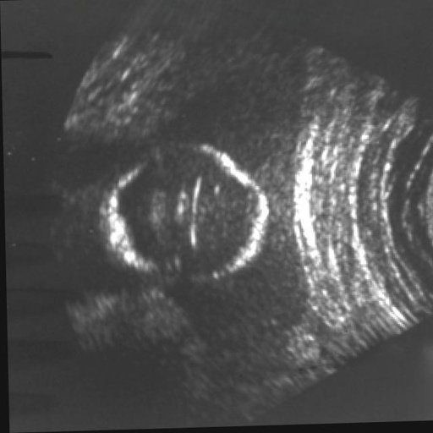
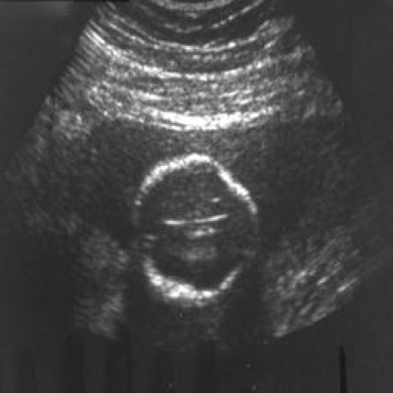
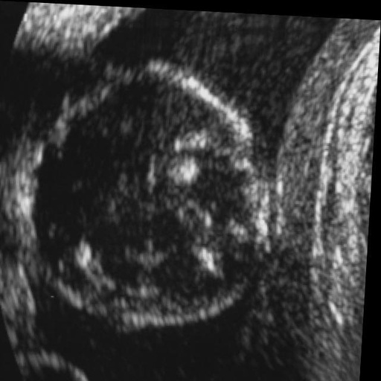
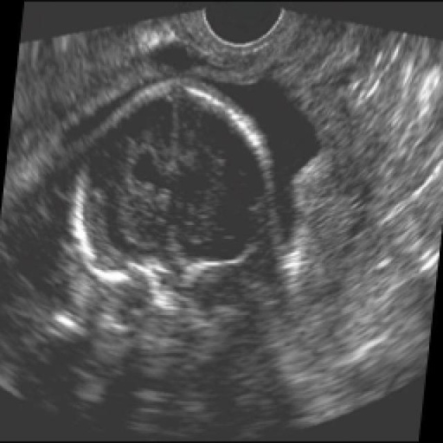
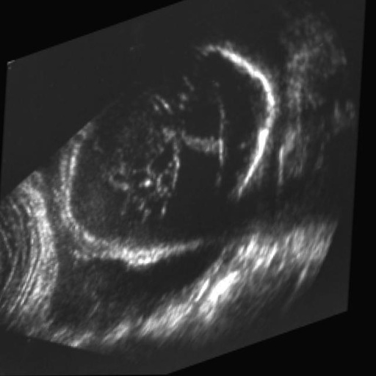
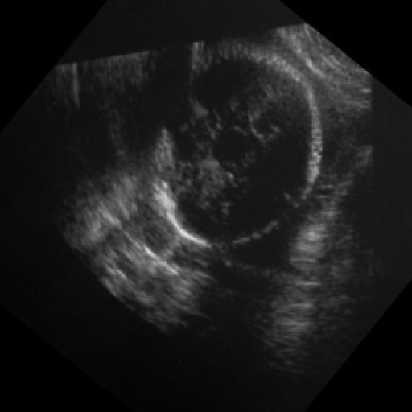
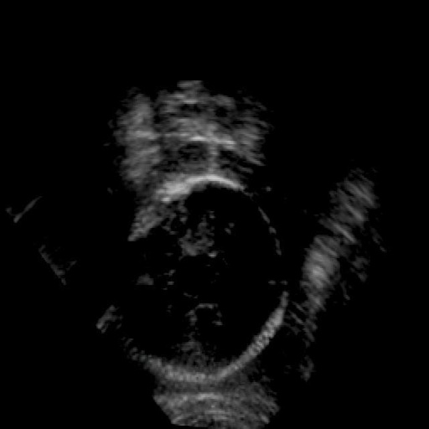
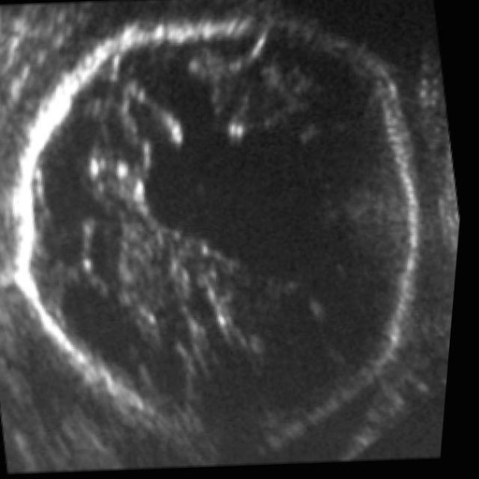
Sample Dataset
8

Slide 9
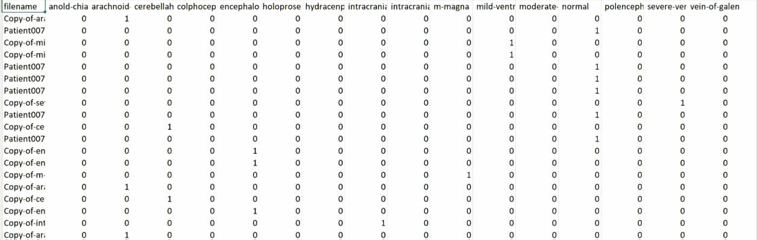
Sample Dataset
9

Slide 10
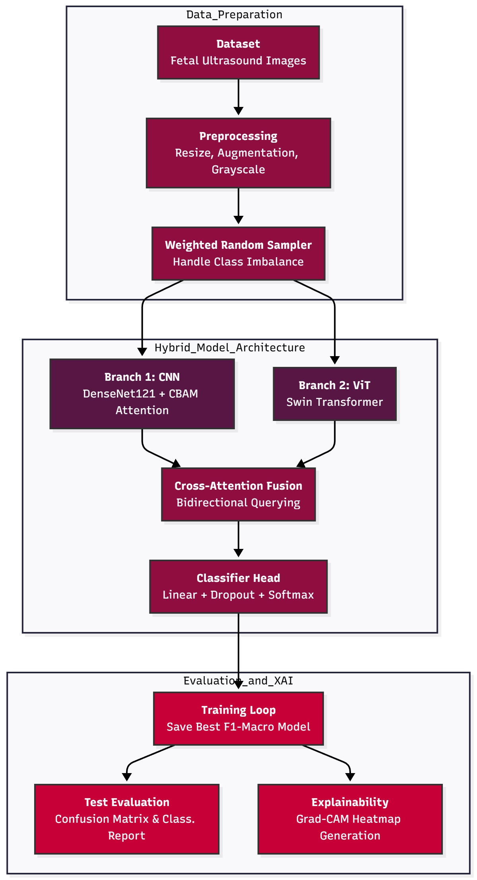
Design
This hybrid architecture fuses a DenseNet CNN and Swin Transformer via Cross-Attention to capture both local details and global brain structure. It addresses data imbalance using weighted sampling and provides clinical transparency by generating Grad-CAM heatmaps to visually explain each diagnosis.
10
Notes:
8

Slide 11
Preprocessing Techniques
Image Standardization
Resized all images to 224 × 224
Converted grayscale to 3-channel format (RGB) for HybridNet compatibility
Normalization: Pixel intensity normalized using standard ImageNet mean and std values
Data Augmentation (Training Only)
Random Resized Crop (scale 0.85–1.0)
Random Horizontal Flip
Random Rotation (15°)
Random Affine transformations (Translation ±10%, Shear 10°)
Color Jitter (Brightness, Contrast, Saturation ±0.1)
Class Balancing: Weighted Random Sampling (inverse frequency) used in DataLoader to mitigate class imbalance
Dataset Loading: Data loaded from pre-structured directory splits (Train, Validation, Test)
11
Notes:
3

Slide 12
Modules
Hybrid Deep Learning Model: DenseNet121 + Swin Transformer
DenseNet121 (CNN Backbone)
Extracts robust local spatial features using dense connectivity
Captures fine-grained morphological details, tissue textures, and edges
Convolutional Block Attention Module (CBAM)
Sequentially applies Channel and Spatial attention gates
Refines CNN features by emphasizing "what" features are important and "where" they are located
Swin Transformer (ViT Backbone)
Models long-range dependencies using hierarchical shifted windows
Essential for understanding global brain geometry and spatial relationships between anatomical structures
Bidirectional Cross-Attention Fusion
Projected feature mixing where CNN tokens query ViT tokens and vice-versa
Synthesizes local textural details with global structural context for a unified representation
Classification Head
Fully connected layers with dropout regularization (0.3)
Generates Softmax probability distribution across fetal brain abnormality classes
Explainability (Grad-CAM)
Computes gradients from the final convolutional layer
Produces visual heatmaps to identify specific anatomical regions driving the diagnosis
12
Notes:
3

Slide 13
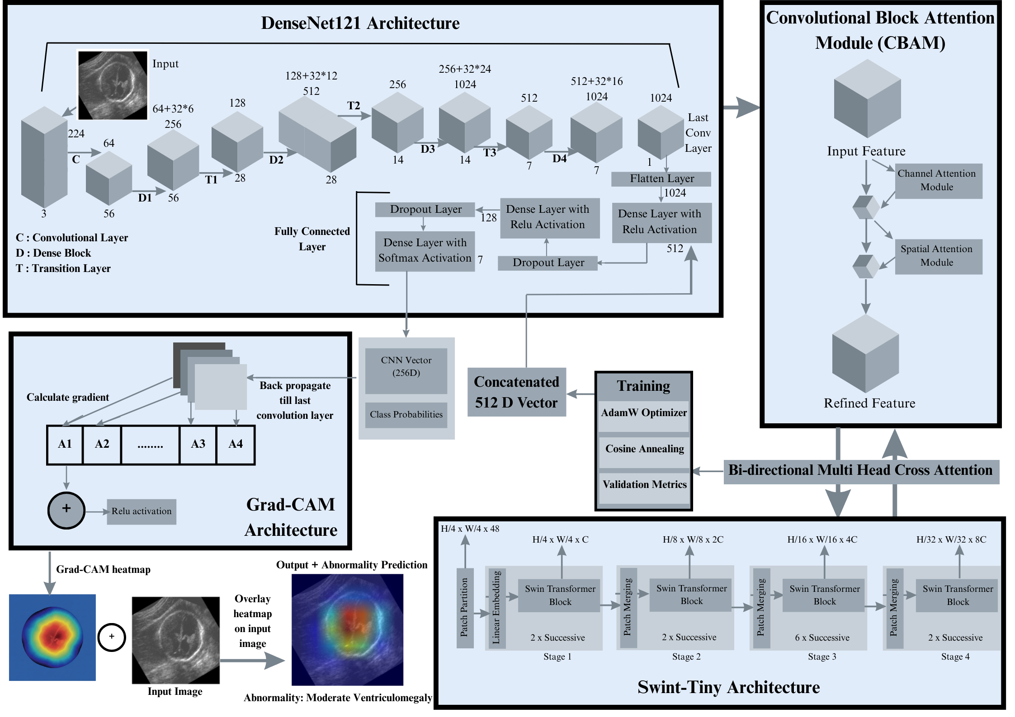
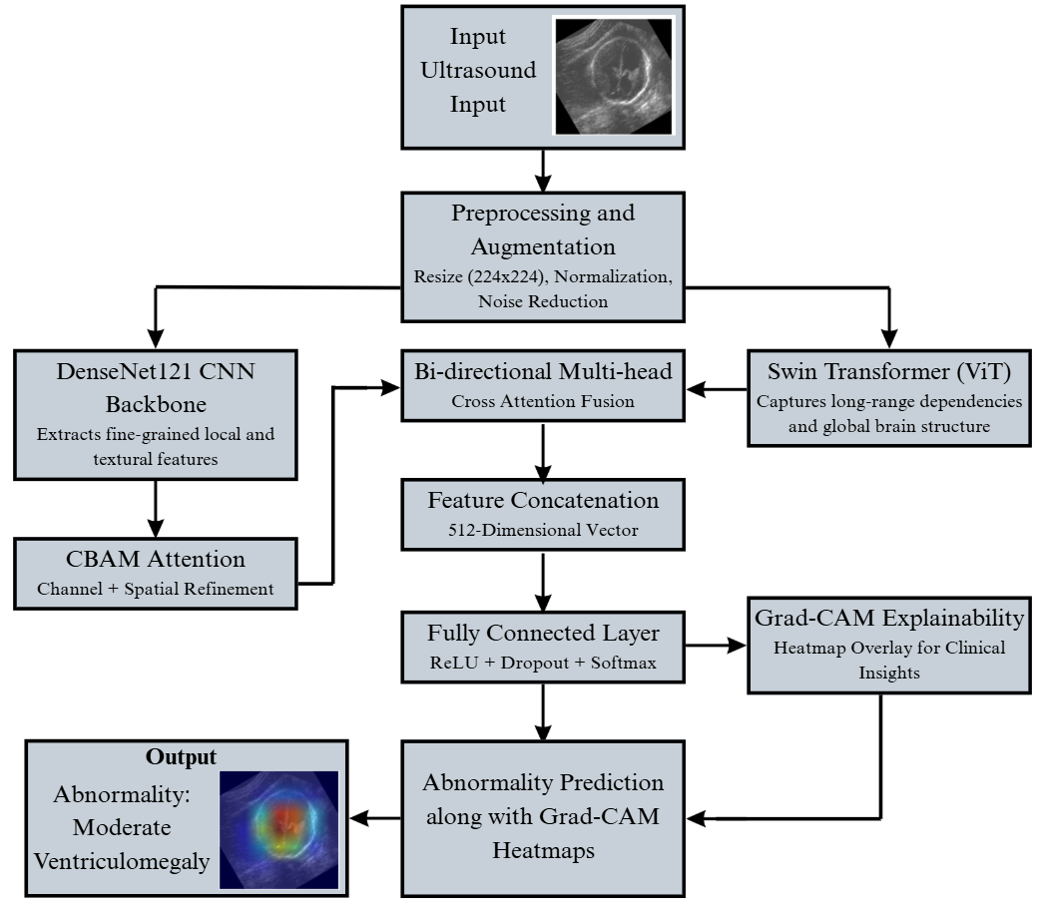
Framework Architecture
12
Notes:
3

Slide 14
Results and Discussion
Model Performance
High Test Accuracy: The model achieved 96% accuracy on unseen data, proving it is highly reliable.
No Overfitting: Training (99.36%) and Validation (98.86%) scores are nearly identical, showing excellent generalization.
Validated Architecture: The results prove the success of the HybridNet design (DenseNet + Swin Transformer).
Strong Recall: A Recall of 0.96 ensures the model rarely misses actual abnormalities.
Balanced Performance: Precision and F1-scores of 0.95 indicate very few false alarms.
High Confidence: Extremely low validation loss (0.0196) confirms the model is very sure of its predictions.
 | Accuracy | Loss
Training | 99.36% | 0.0132
Validation | 98.86% | 0.0196
 | Accuracy | Precision | Recall | F1-Score
Test | 96% | 0.95 | 0.96 | 0.95
13
Notes:
8

Slide 15
Comparison with other models
Ref No. | Year | Method | Accuracy / Metric | Pros & Cons (from Literature Survey)
[24] | 2025 | Xception | ~85% | Pros: Efficient due to separable convolutions. Cons: Limited by short training (5 epochs) and small dataset⁴.
Proposed Modl | 2025 | Hybrid DenseNet-121 + Swin-Tiny ViT | 96% (Test Acc) | Pros: State-of-the-Art; Bidirectional Cross-Attention; Handles class imbalance (11 classes); Explainable. Cons: Computational requirements may challenge low-resource settings.
13
Notes:
8

Slide 16
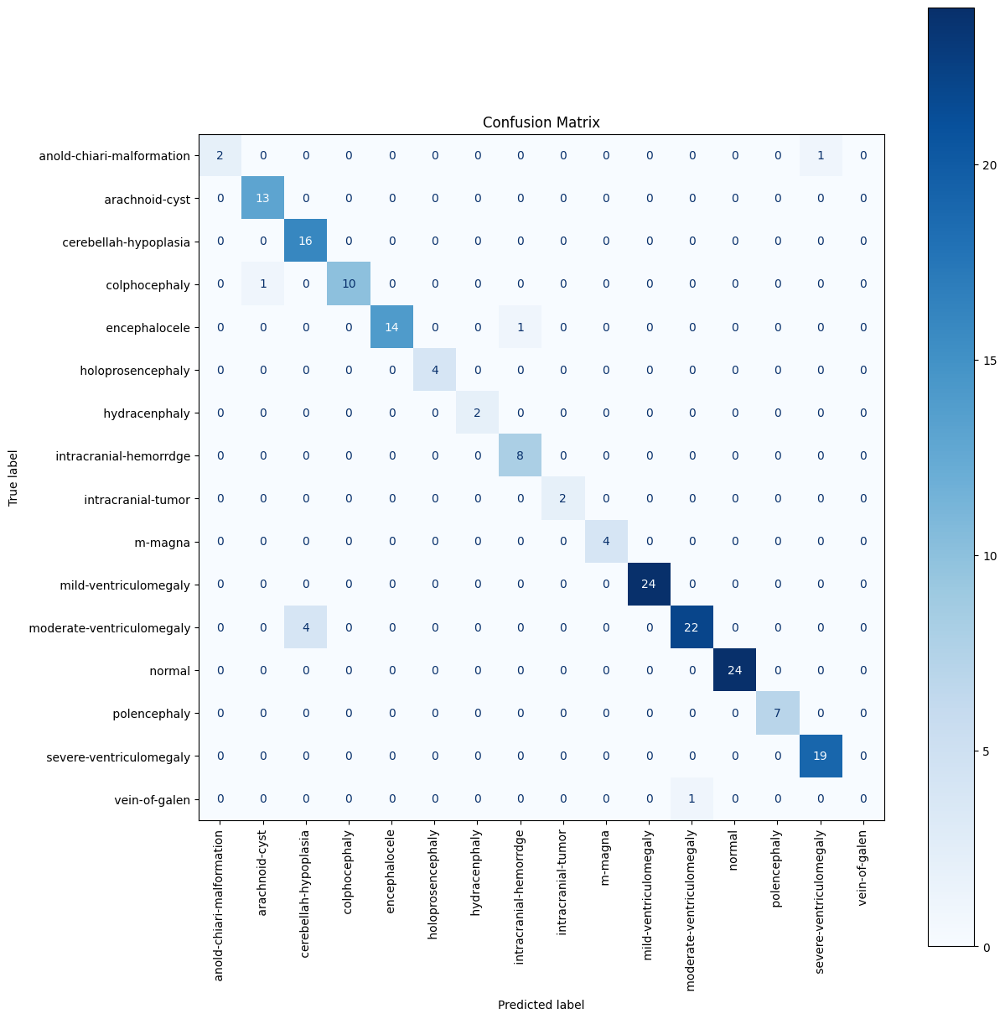
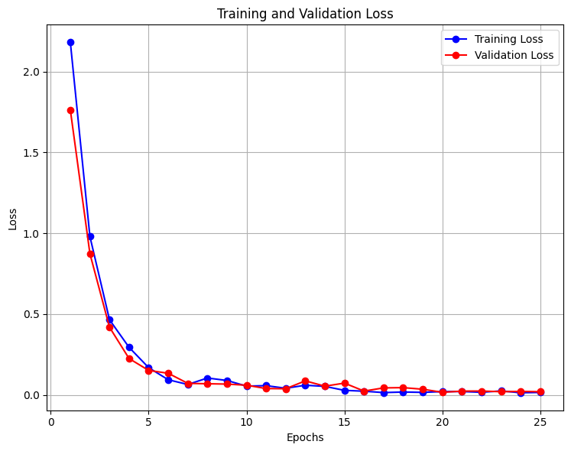
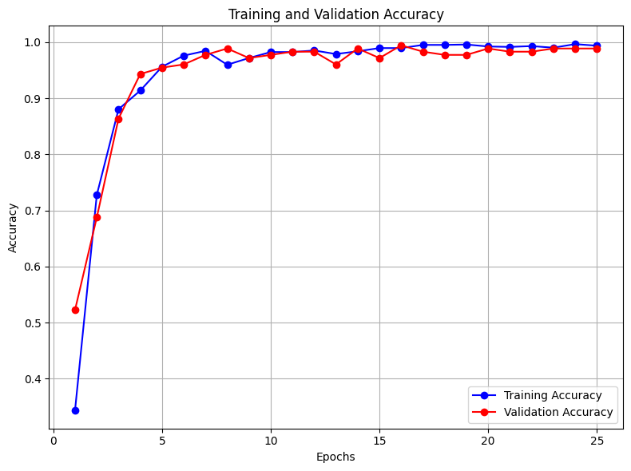
Results and Discussion
Loss Curves and Confusion Matrix
14
Notes:
8

Slide 17
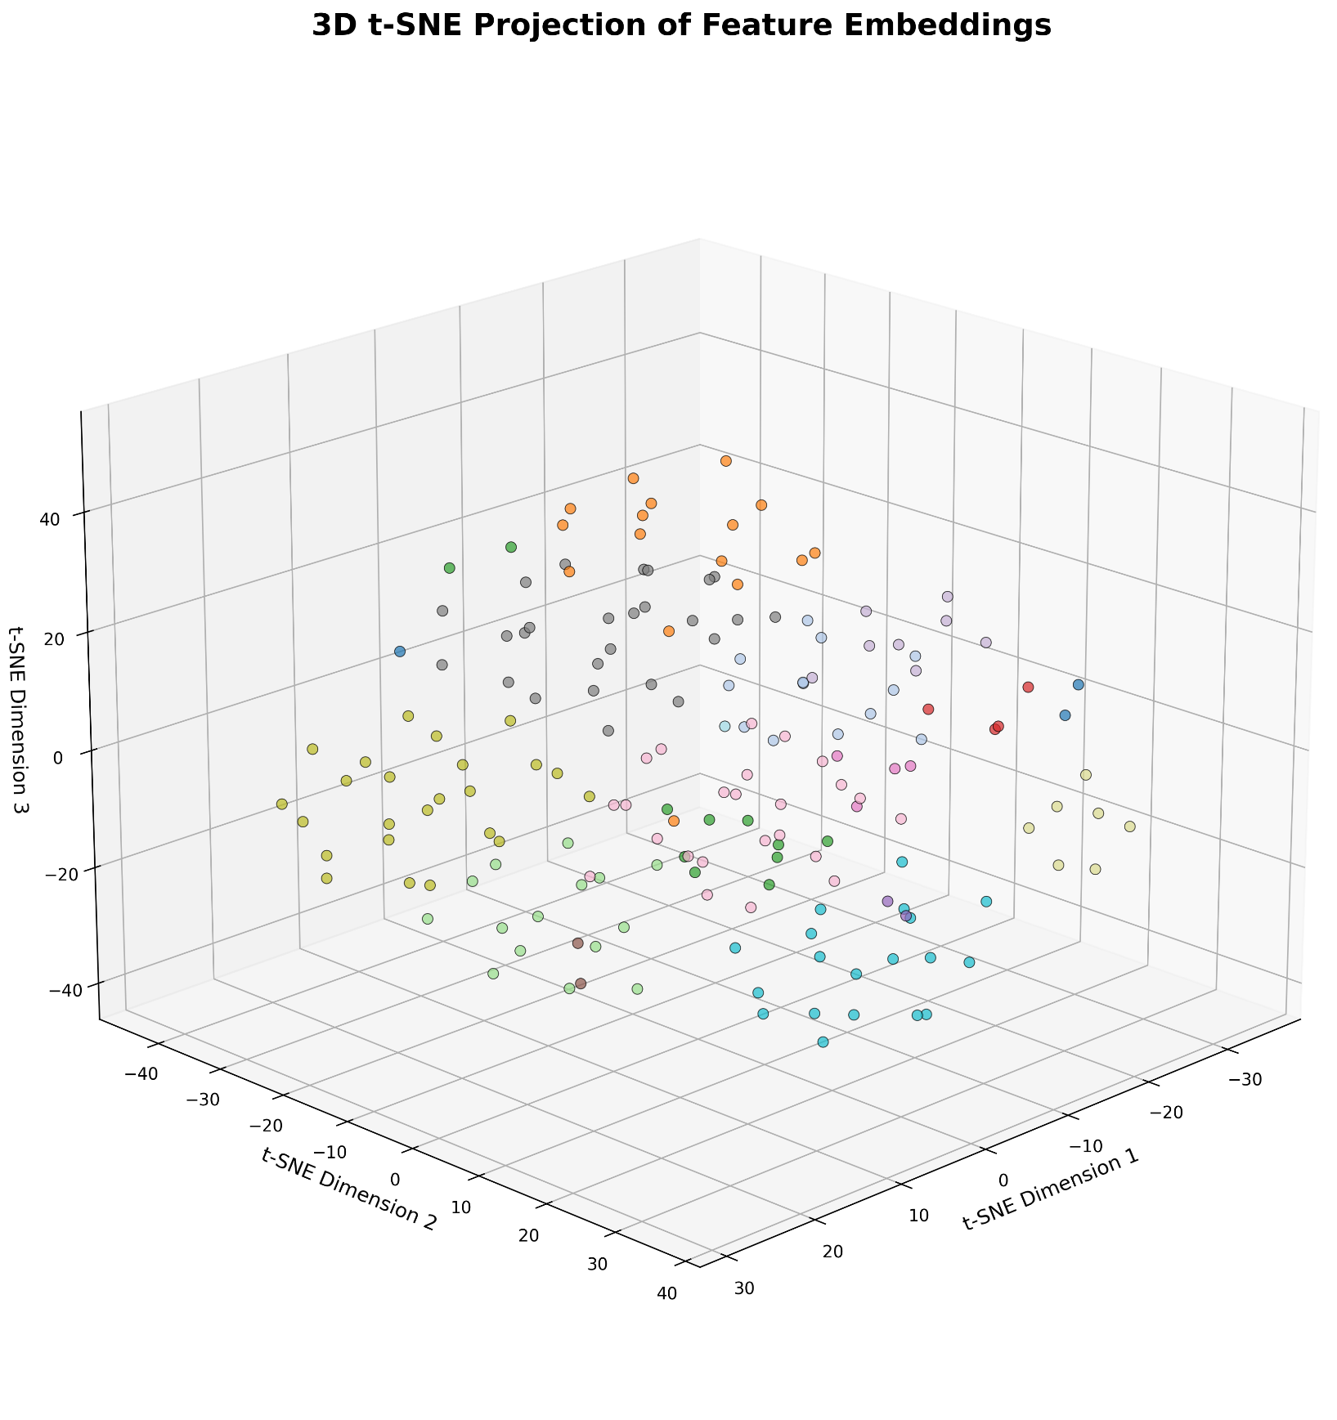
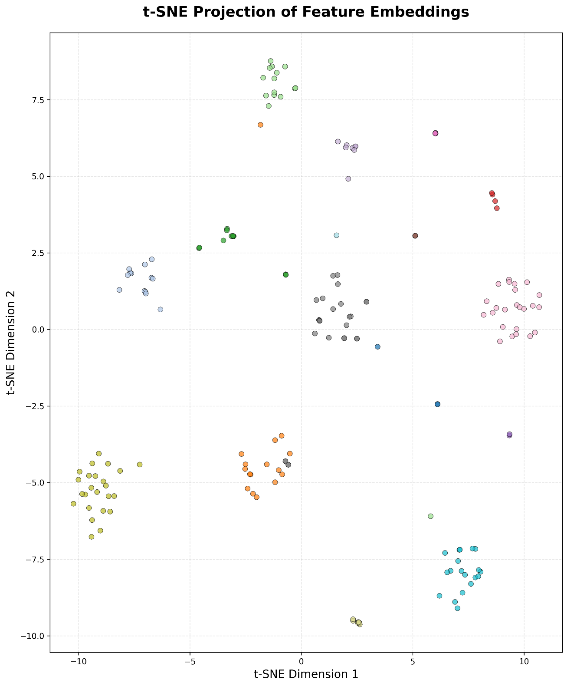
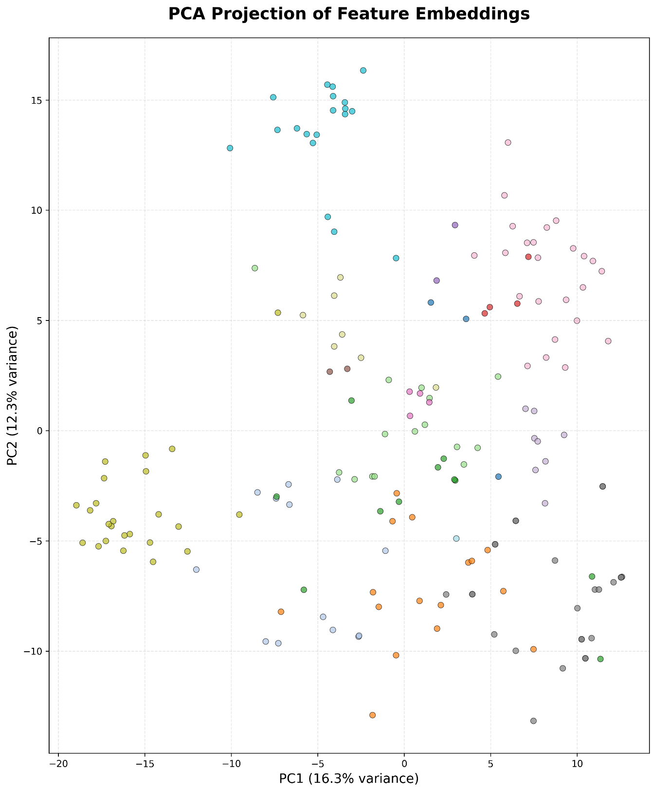
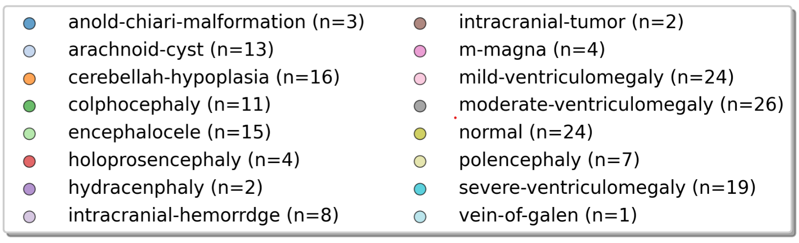
Results and Discussion
T-SNE and PCA Plots
14
Notes:
8

Slide 18
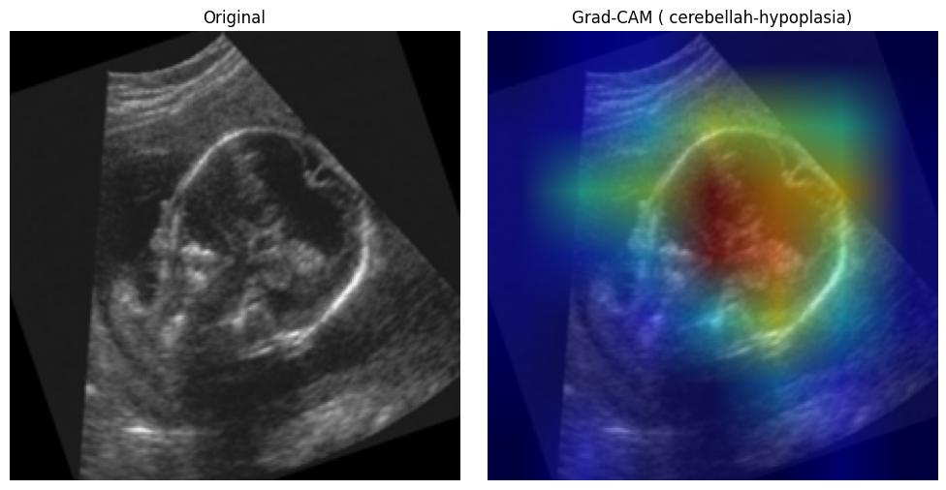
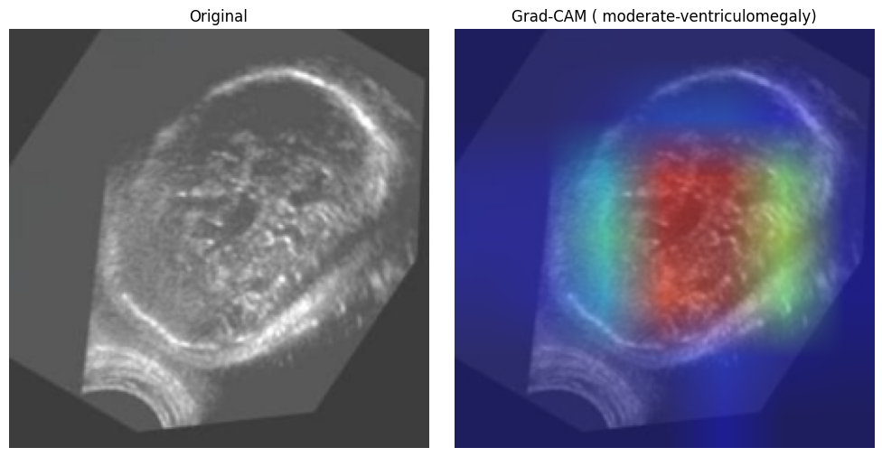
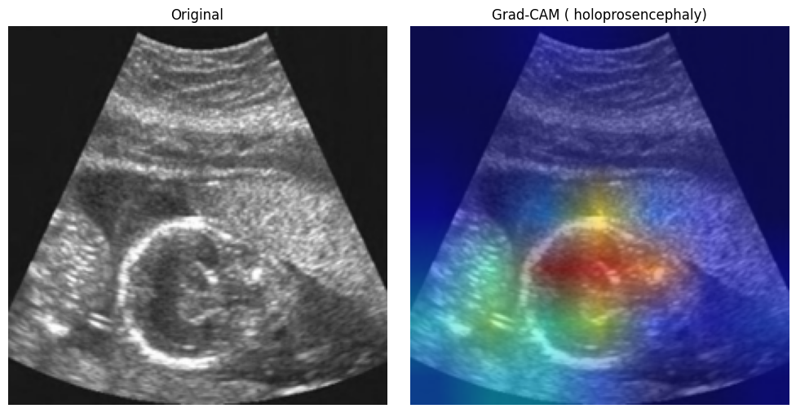
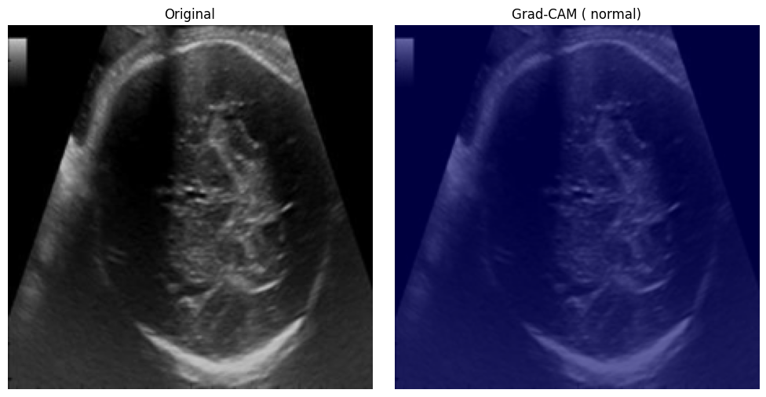
Results and Discussion
Grad-CAM Heatmaps
14
Notes:
8

Slide 19
Conclusion
Novel Hybrid Framework: Successfully developed HybridNet, combining the strengths of DenseNet121 (CNN) and Swin Transformer.
Advanced Feature Fusion: Implemented a custom Cross-Attention mechanism to intelligently merge local anatomical details with global context.
Medical Applicability: Created a robust pipeline capable of classifying complex fetal brain abnormalities from ultrasound images.
Explainable AI: Integrated Grad-CAM visualization to provide interpretability and build clinical trust in the model's decisions.
Data Robustness: Effectively handled class imbalance and data scarcity through advanced augmentation and weighted sampling techniques.
Ready for Deployment: Delivered a high-performance system suitable for assisting radiologists in automated prenatal screening.
15
Notes:
8

Slide 20
References
K. P. Shirsat, S. Gawade, S. Chopade, R. V. Gujare, and R. Bhandwalkar, “Fetal brain anomaly detection via ultrasound imaging using traditional and separable cnns with xception,” Journal of Neonatal Surgery, vol. 14, no. 22S, pp. 804–813, 2025. [Online]. Available: https://www.jneonatalsurg.com/index.php/jns/article/view/561
O. O. Agboola et al., “Deep learning approaches to identify subtle anomalies in prenatal ultrasound imaging,” Path of Science, vol. 11, no. 6, pp. 3019–3026, Jun. 2025.
U. Islam et al., “Fetal-net: Enhancing maternal-fetal ultrasound inter pretation through multi-scale convolutional neural networks and trans formers,” Scientific Reports, vol. 15, p. 25665, Jul. 2025
R. Singh et al., “Attention-guided u-net++ with grad-cam++ for robust fetal head segmentation in noisy ultrasound images,” Scientific Reports, vol. 15, p. 19612, Jun. 2025.
X. Zhang et al., “Advancing prenatal healthcare by explainable ai en hanced fetal ultrasound image segmentation using u-net++ with attention mechanisms,” Scientific Reports, vol. 15, p. 30012, Jun. 2025.
16
Notes:
9

Slide 21
THANK YOU
16

